Slide 1
CS 439 25F Project
Economic Input-Output Model
Group 23
Ryan Vukicevic (rcv35)
Lawrence Ho (lh811)
Paolo Gervasoni (pg681)

Slide 2
Project Description
We are looking to analyze the difference between 25 different national economies and their structures given Input-Output models and potentially forecast certain effects of the economies.
We will compute the Leontief matrices for each country using their respective input–output tables. This will allow us to analyze the structure of inter-industry relationships within each economy to identify key sectors.
x = Ax + y => x = (I - A)⁻¹y

Slide 3

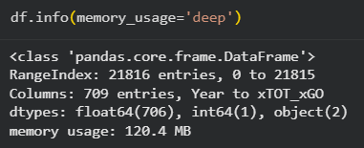
Dataset Description and Sample Snapshots
As illustrated by screenshots, the original dataset was an Excel spreadsheet of 172 MB, the CSV conversion for faster data loading is still above the threshold for full bonus points at 123 MB in file explorer, and 120 MB according to Pandas
Screenshots give Dataset Size, Record Size, #Records, Entry Size

Slide 4
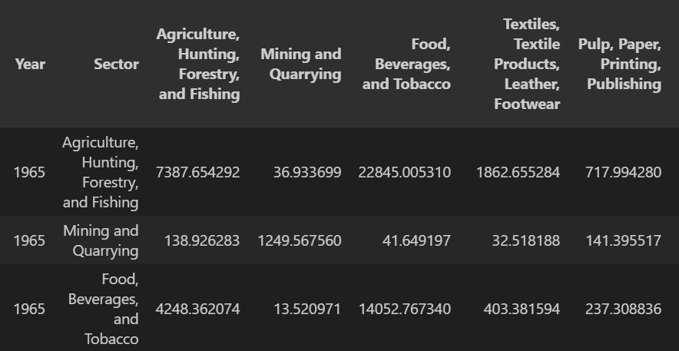
Dataset Description and Sample Snapshots
Dataset Name: Initial WIOD (World Income-Outcome Database) Project
Link: https://www.rug.nl/ggdc/valuechain/long-run-wiod
It covers 25 countries, and a category for the rest of the world, from 1965-2000
Interactions between ISIC sectors, sector-sector transactions across nations
The sector in each row is the seller, the columns are the buyers, the amount is in millions USD
Components of output in the dataset is given by
Expenditure by Household (C)
Expenditure by Government (G)
Gross Fixed Capital Formation (I)
Change in Inventory (ΔI)

Slide 5
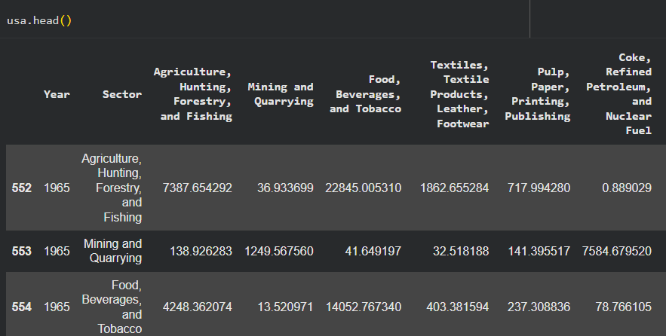
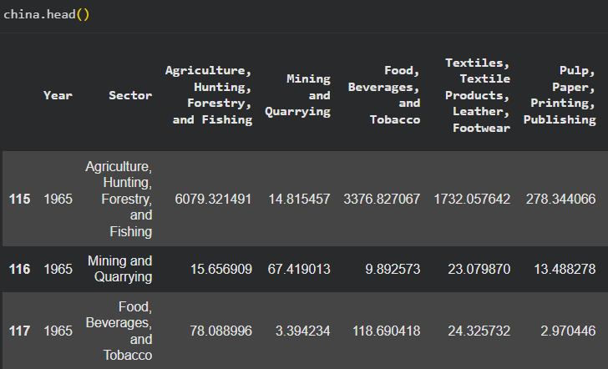
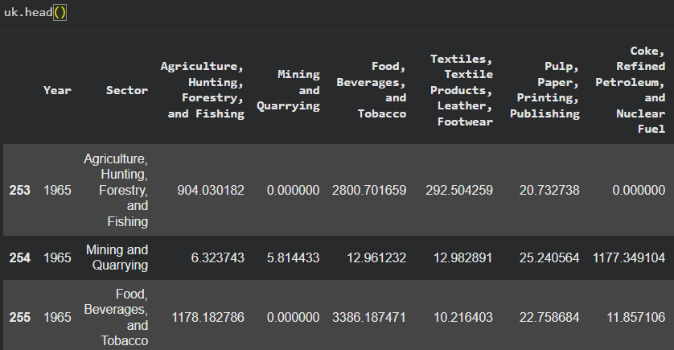
Dataset Snapshots per Table
Each table represents inter-sectoral transactions for a specific country and year.
Rows indicate producing sectors, while columns indicate consuming sectors.
Values are expressed in millions of USD.
Shown here: examples for USA, Great Britain, and China (1970), representative of the 25 country dataset.
These data snapshots are later used to compute each country’s A (Input–Output coefficient) and L (Leontief inverse) matrices.

Slide 6
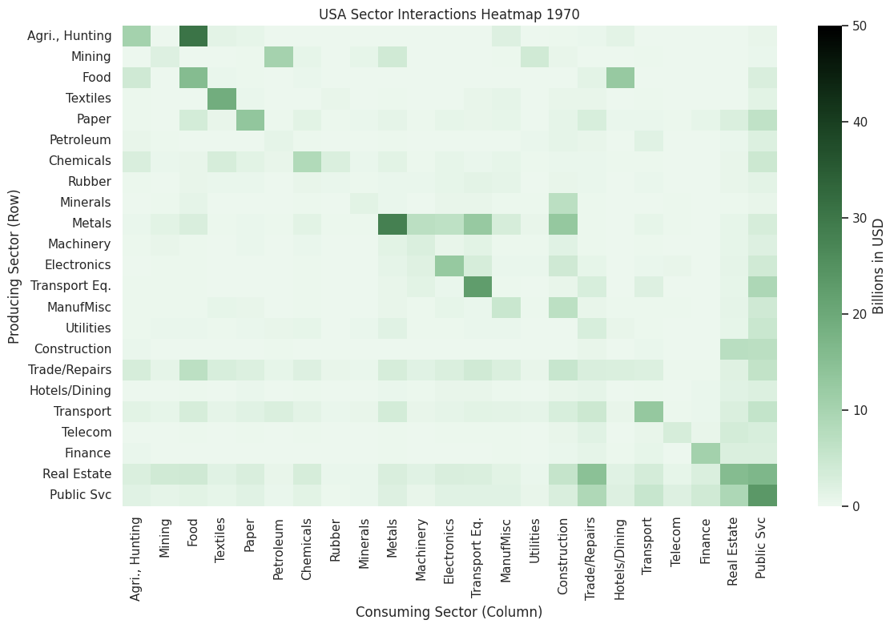
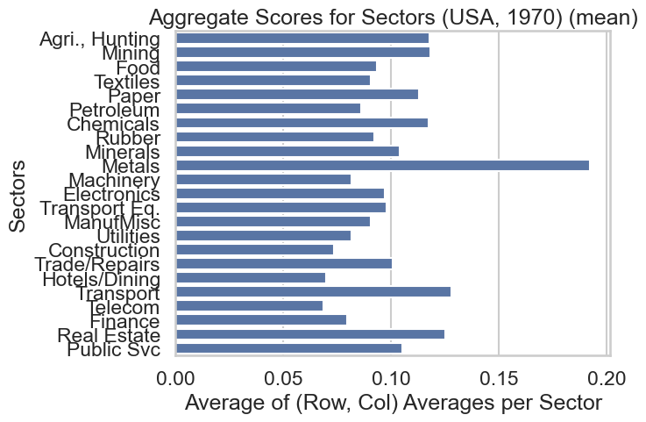
Dataset Sample Stats. Plots (USA)
USA 1970 Input–Output sector interactions
Heatmap: Intensity of flows between producing and consuming sectors
Bar chart: Average aggregate contribution per sector
Key sectors: Metals, Finance, and Public Services show strongest activity
Baseline patterns used to compute the USA’s A and L matrices

Slide 7
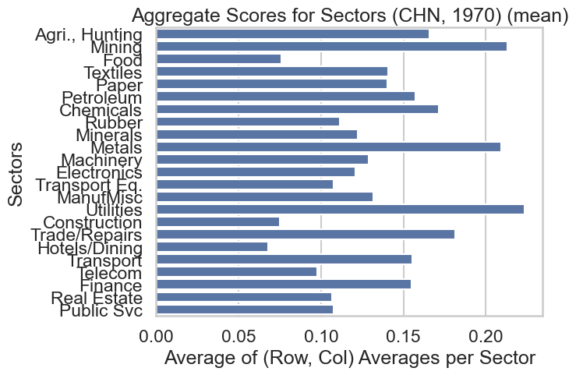
Dataset Sample Stats. Plots (China)
China 1970 Input–Output sector interactions
Heatmap: Visualizes domestic inter-sector dependencies
Bar chart: Highlights major sectors driving output
Key Sectors: Manufacturing, Construction, and Trade
Similar matrix structure used for global comparisons

Slide 8
Questions to be Addressed
Analyze the structural similarities/differences between the domestic makeups of output for each economy by sector.
Implement KNN Classification on L to explore the similarities and differences of the countries
Are you able to differentiate between countries regionally given L matrices?
Analyze potential regional differences?
Interpret the Leontief Matrices to understand the structure of economies.
Using Decision trees, visualize the the splits and key decision splits of classifying regional economies.
Investigate the reliability of Leontief inverse matrices to classify or (‘group’) countries by region.
Implement K-Means clustering to see if we can also precisely split the countries into the same 3 regions using the same L matrices.

Slide 9
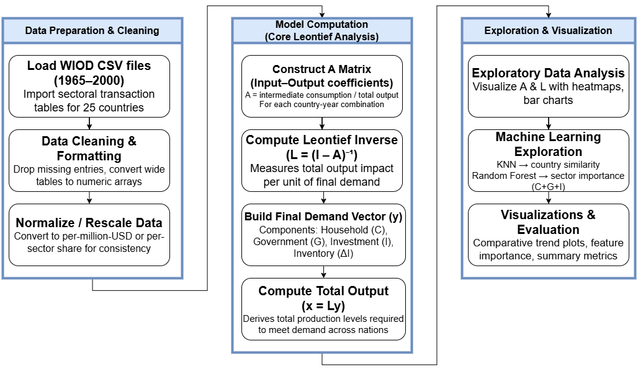
Data Transformation Flowchart

Slide 10
Exploration Algorithms Used
Matrix-based Input Output Analysis:
Implemented the Leontief Model (x = Ax + y => x = (I - A)⁻¹ y) to quantify industry dependencies and estimate total output required to meet final demand
Statistical Summarization:
Computed yearly summary statistics (mean, median, minimum, maximum) of sector-sector relationships to evaluate and compare economic growth among countries over time
Data Visualization Algorithms:
Used Seaborn and Matplotlib for heatmaps, line plots, and comparative temporal trend analyses, enabling the visualization of sector interactions and national output evolution.
Iterative Exploration Loops:
Developed Python loops to iterate across countries and years, making visual summaries and sectoral comparison matrices.

Slide 11
Computational Platform and Software Libraries Used
Development Environment:
Google Colab — used for cloud-based execution of Jupyter notebooks and seamless collaboration.
Data Loading:
Google Drive Library — accessed and read large .csv files (≈120 MB WIOD dataset) directly from Drive.
Preprocessing and Analysis:
NumPy, Pandas — for data wrangling, matrix operations, and computing Input–Output coefficients.
Visualization:
Matplotlib, Seaborn — for generating line plots, heatmaps, and sectoral trend visualizations.

Slide 12
Gantt Chart
Task | Person | Days
Project Setup & Data Collection | Ryan Vukicevic | 1
Data Cleaning & Preprocessing | Ryan Vukicevic | 2
Matrix Computation Function (A, L, x = Ly) | Lawrence Ho | 2
More Preprocessing (Labeling Data) | Lawrence Ho | 1
Visualization (Heatmaps, Plots) | Paolo Gervasoni | 1.5
Evaluation & Final Presentation Prep | Paolo Gervasoni | 1.5

Slide 13
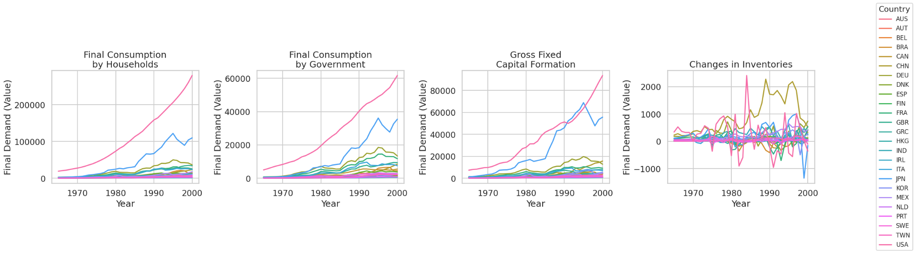
Visualizations Samples
Displays final demand trends across 25 countries
Final C, G, I shows a upward trend over the years from 1965-2000. This is expected as productivity and income increases over time (without adjustment for inflation).
Changes in inventory tracks the volatile component of Investments in GDP.
Notes:
https://www.rug.nl/ggdc/html_publications/memorandum/gd190.pdf

Slide 14
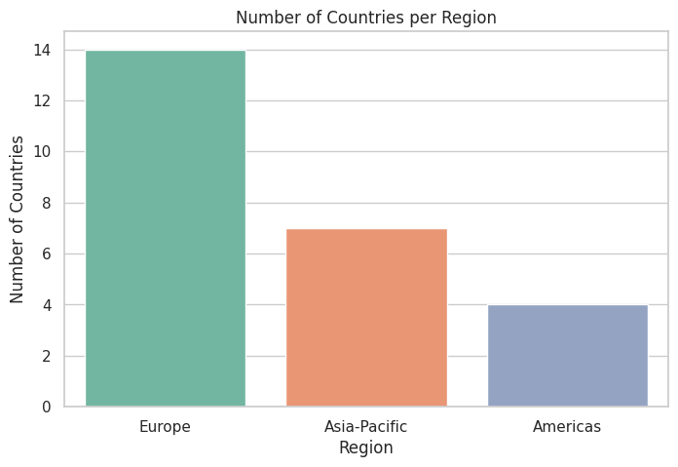
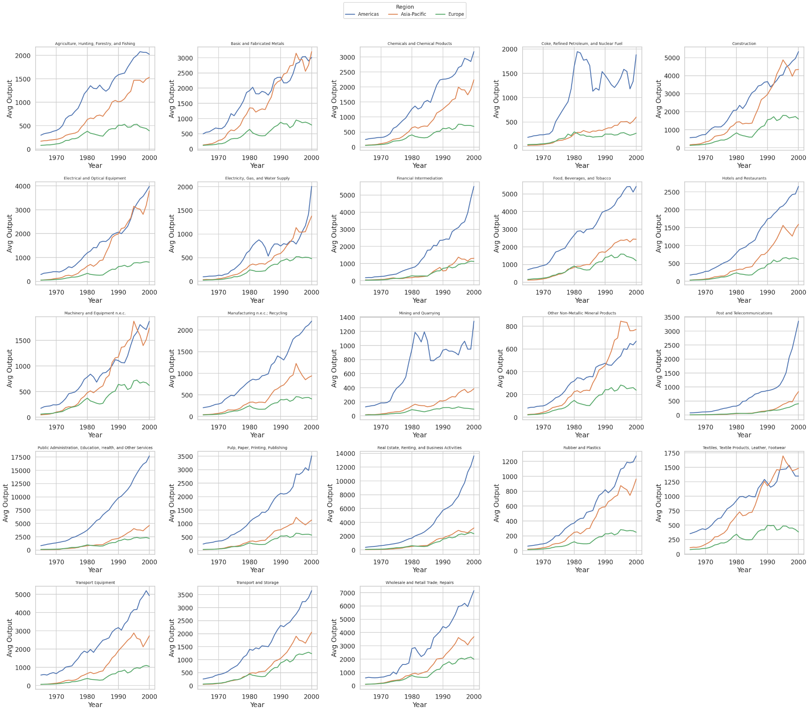
Visualizations Samples
*caveat: Australia is classified as Asia-Pacific although more precise would be Oceania but they’re the only country with that classification
Some visualization regarding the regions in our data
Geographic regions Europe 14, Asia-Pacific- 7 Americas- 4,

Slide 15
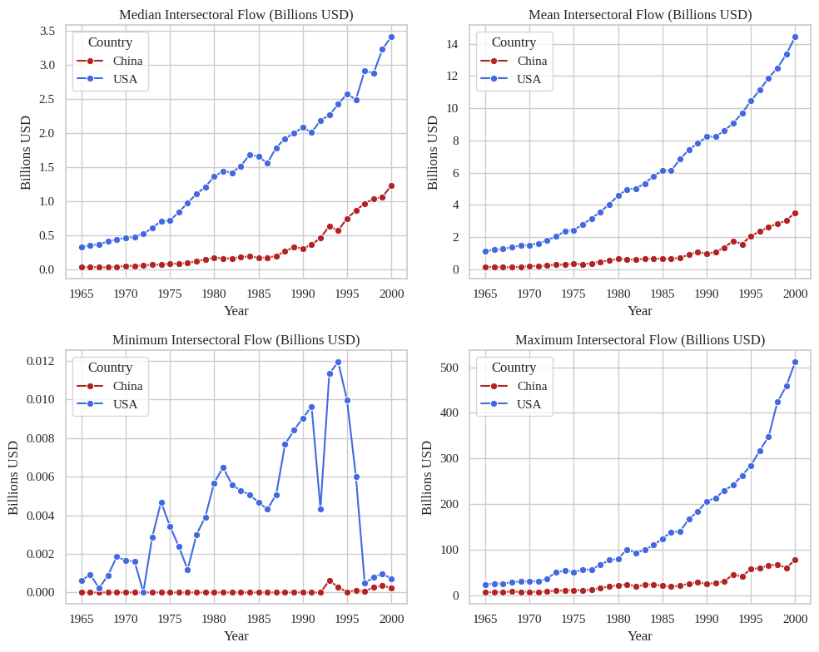
Visualizations Samples
Compares intersectoral flow trends across 25 economies (examples shown: USA, China).
Mean and median flows steadily increase for both nations, reflecting rising industrial connectivity.
The maximum flow in the USA shows rapid post-1980 acceleration indicating economic scaling effects.

Slide 16
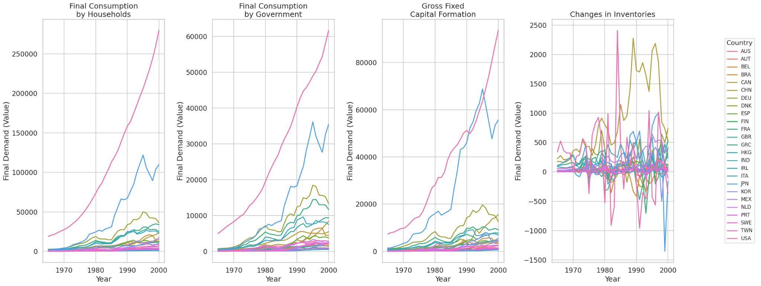
Dashboard Mock Up
Country-Year Selector and Heatmap View
Dropdown to select Country and Year (1965–2000)
Displays sectoral flow heatmap (A or L matrix) for the chosen country-year
Key Sector Summary
Shows top 3 sectors driving output (C + G + I)
Highlights growth rate or contribution %
Final Output Components Trend Panel
Displays side by side comparisons
Comparative Insights Panel

Slide 17
Evaluation Techniques
Initial Validation:
Verified consistency of A and L matrices across 25 countries and years (1965–2000).
Compared computed total outputs (x = Ly) with WIOD reported aggregates.
Model Evaluation:
Used KNN to determine regional industry similarity.
Random Forest to identify key sectors driving aggregate output (C + G + I).

Slide 18
Interesting Findings I

Slide 19
KNN Results
Summary: Per year samples were not large enough to reliably classify regions and their economies. The model defaulted to Training on all available data led to extremely high accuracy leading to the question whether forecasting was actually possible (ie testing on unseen data). Also, explored methods of dimensionality reduction to try to combat potential overfit and maintaining robustness of euclidean distances.
Applied KNN on the Leontief inverses computed per country per year. Model parameters found via GridSearch

Slide 20
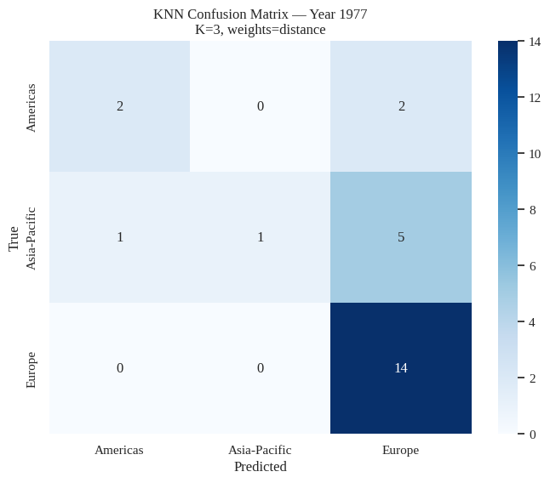
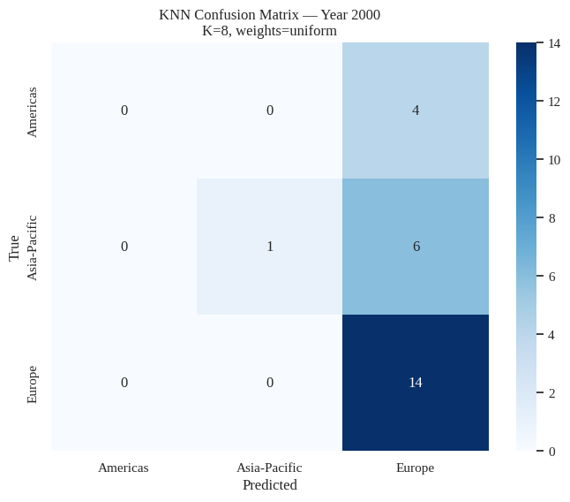
Fitting A KNN Model Per Year
Visualizing the model selection, we see the average CV accuracy was never higher than ~85%. A quick visual observation shows many of these models optimal accuracy hover around ~70-75%
An optimal KNN model trained on one year of data (ex: 1977 & 2000) produces low accuracy. The sample of 25 countries is too small and the model is unable to pick up on key features to differentiate the regions. Thus, the model ends up predicting the dominant class (due to class imbalance).
*for reference, all models trained with 80/20 train/test split

Slide 21
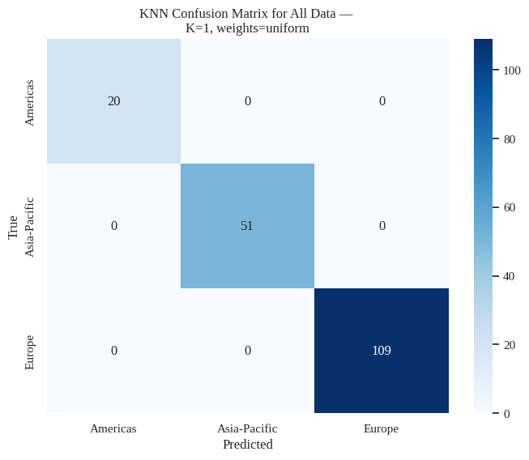
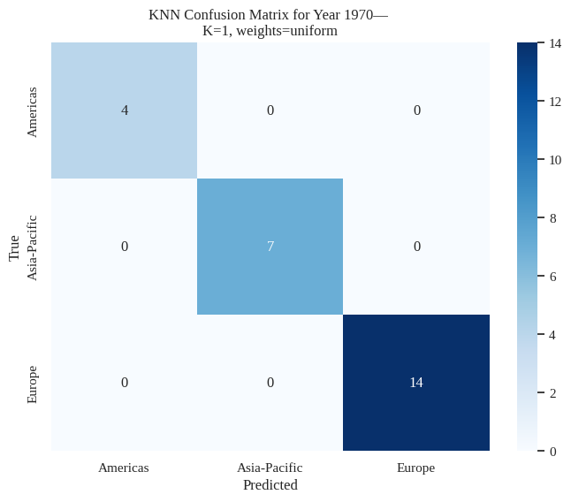

Fitting KNN on All Data
Taking all the data from (1965-2000) and training a model (80/20 train/test split), testing accuracy is perfect. Implications of structural differences per region. Questions do arise in regards to predictive power and dimensionality.
Testing on year specific data also produces perfect accuracy. (Below ex: of 1970 and 2000). More evidence to support that there are structural differences in regional economies. However we also observe low k which leads implies dimensionality issues.
Notes:
Predictive power as in on patterns that are completely unseen at all (ie future years)

Slide 22
Dimensionality concerns
There are 23 Features in our inverse Leontief matrix and all matrices are square to determine sector-sector interaction.
When flattened, dimensions are 1x529
One country X 529 entries (23²)
25 countries implies 529 entries per year per country
35 years of matrices
In such high dimensions, Euclidean distance becomes less robust as all points are “close together”.
To address this, we use PCA to see if we can maintain robustness and reduce dimensionality.
Notes:
https://www.geeksforgeeks.org/machine-learning/curse-of-dimensionality-in-machine-learning/

Slide 23
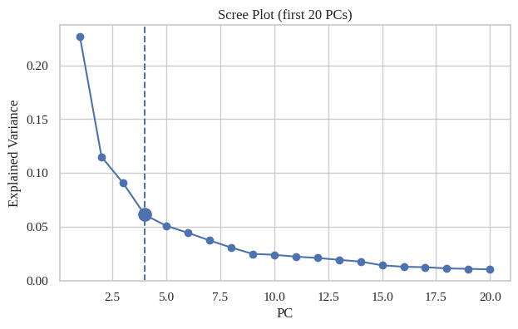
PCA: All available data
Using the same Training set that was used to fit the earlier KNN model
Plotted PCA Scree plot of explained variance captured with first 20 PC
Using Kneedle point to help determine “elbow point” (ie: optimal PC)- 4 PC’s
Kneedle finds the point where the function goes from steep to flat. In this case, it’s capturing the most explained variance until the change in captured variance diminishes.
Notes:
https://raghavan.usc.edu/papers/kneedle-simplex11.pdf

Slide 24
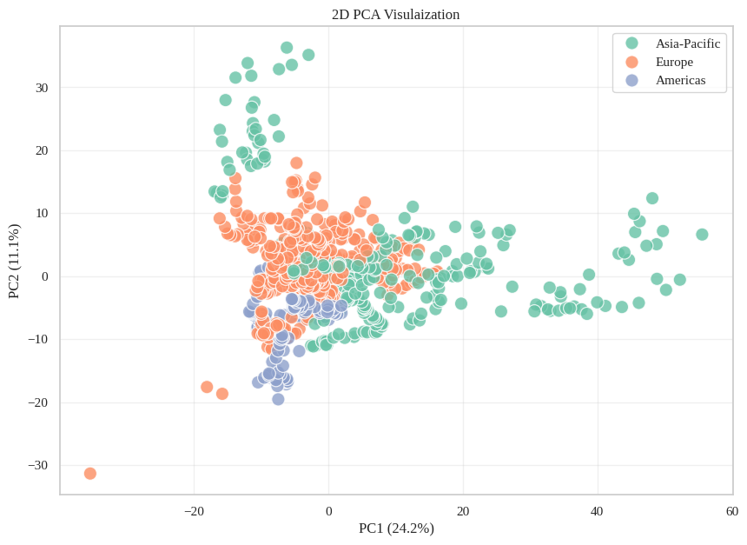
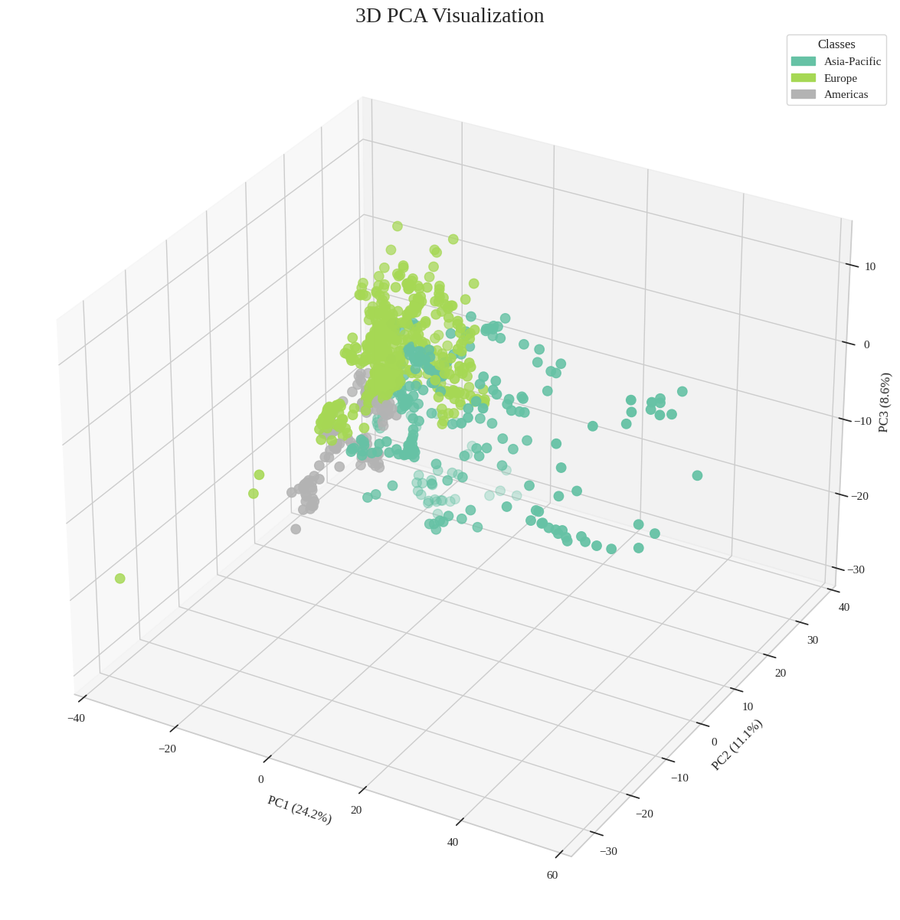
PCA Clustering Visualizations

Slide 25
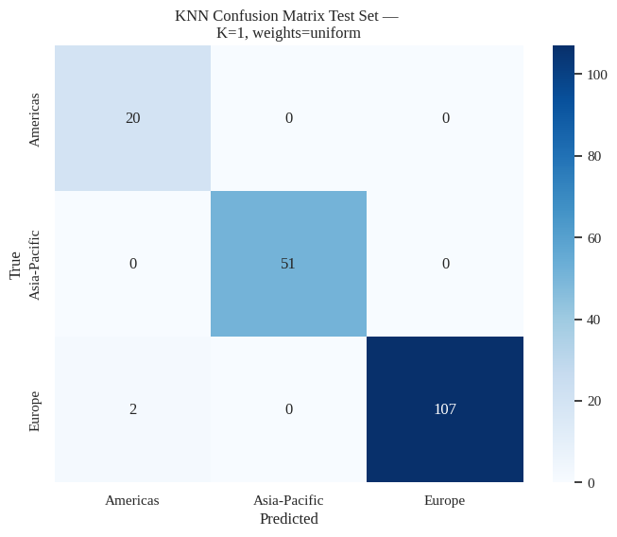
KNN on Reduced Data
On the same test set, we see two misclassified instances. Recall, the model trained on the full dataset had no misclassification. This models’ performance may have lower a misclassification but, it’s only marginally worse. the consistent high performance leads me to believe that there are inherent economic differences between regions. We will test the forecastability of the Leontief inverses.

Slide 26
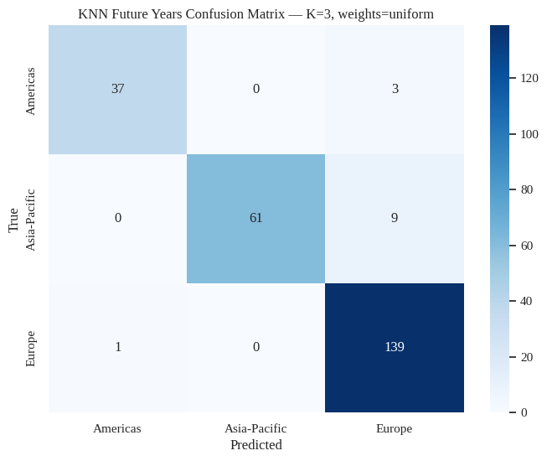
Forecastability of the Leontief Matrices
Training a KNN model on a subset of data ranging from years 1965-1990. The model will be blind to these future years and if it’s still able to differentiate these regional economies it further supports the existence of structural differences.
Model fitting metrics
Train Accuracy: 0.9985
Test Accuracy: 0.948
A question that comes up: Is class imbalance affecting the model too heavily or are there specific instances causing misclassification?

Slide 27
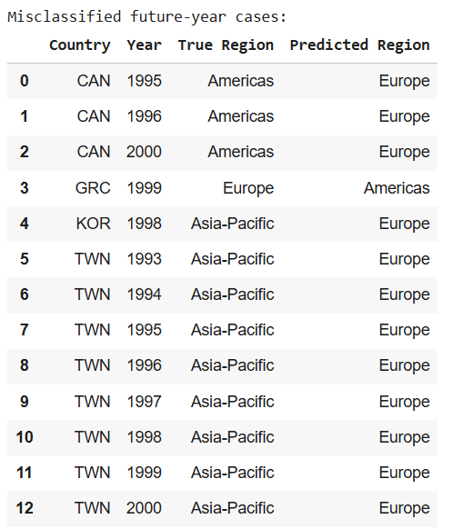
Investigating Misclassification
Korea 1998- Foreign investment collectively pulled out of Korea leading “to a sharp contraction of economic… a negative 6.7 percent growth, the worst in modern Korean history.”.
Taiwan 1990’s- Massive political overturning and democratization could have be a potential explanation. (Key sectors to look for may be government spending metrics).
Canada Late 1990’s- Canada was freshly out of a recession (early 1990’s) and typically, these economies post recession experience a peak or “boom” (expansionary stage) before stabilizing to a more consistent level state. (lifecycle of economies)
Greece 1999- Greece began implementing labor laws regarding foreign nationals. Also, their nation’s debt is relatively high which could affect the sector to sector behavior of the economy.
Notes:
https://www.imf.org/external/pubs/nft/seminar/2002/korean/#:~:text=The%20crisis%20led%20to%20a,worst%20in%20modern%20Korean%20history.
https://www.investopedia.com/terms/e/economic-cycle.asp
https://www.eurofound.europa.eu/en/publications/all/1999-annual-review-greece

Slide 28
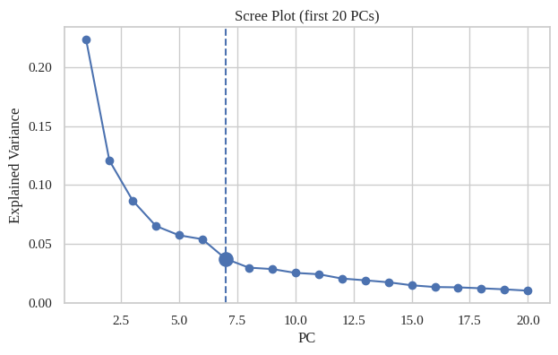
PCA: Subsetted Years
To address the same potential dimensionality concerns,
Using the same Training set that was used to fit the earlier KNN model
Plotted PCA Scree plot of explained variance captured with first 20 PC
Again, used Kneedle point to help determine “elbow point” (ie: optimal PC)- 7 PC’s
Notes:
https://raghavan.usc.edu/papers/kneedle-simplex11.pdf

Slide 29


PCA Clustering Visualizations

Slide 30
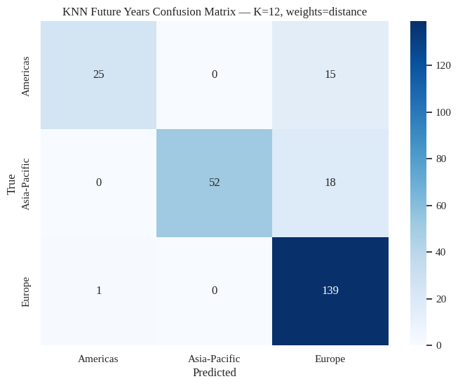
Reduced KNN on Future Years
Metrics for the model
Train Accuracy: 1.0
Test Accuracy: 0.864
Poorly performing after dimensionality reduction. The high train and low test accuracy tells me PCA causes key variance to be lost in the model, thus losing it’s predictive power. You can also see the overpowering prediction of the Europe class.

Slide 31
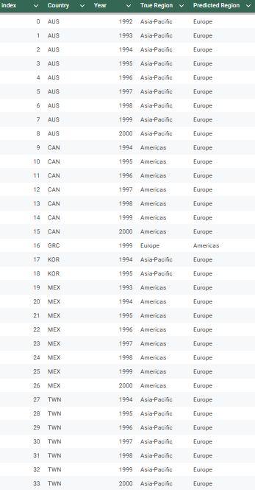
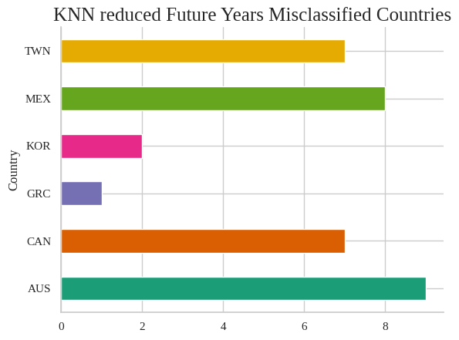
Lost too much important information and is unable to classify countries well, ended up heavily classifying based on class imbalance.

Slide 32
Takeaway
There are inherent regional differences in economic structure.
This is seen in our fairly high success in classifying regions based on Leontief inverses
However, the differences are very likely due to very specific industry and sectoral composition.
We see this as PCA generally reduces the performance metrics of our model and it’s classification.
Since PCA generalizes the variance of features to reduce dimensions, we lose the exact/key signals that allow for differentiating regions.

Slide 33
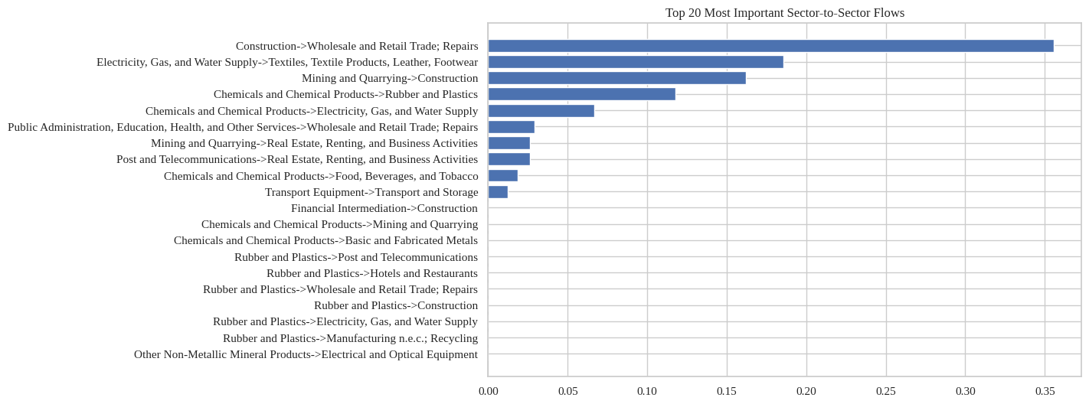
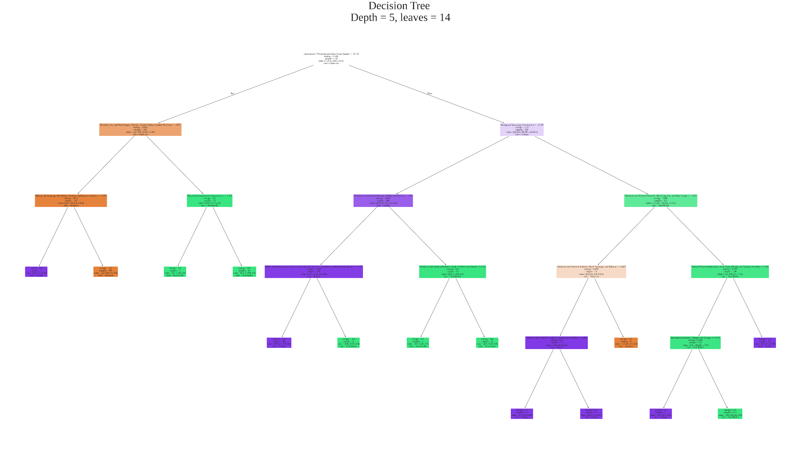
Decision Tree
For interpretability, implemented a Decision Tree on all available data to visually inspect the specific sector -> sector interactions that differentiate the regions.
The tree seems somewhat complex but when inspecting the fitting, we see the train and test accuracy are relatively high/similar.
Train Accuracy: 1.0
Test Accuracy: 0.9833333333333333
This indicates a relatively well-fit model that captures the key structural relationships between sectors.

Slide 34
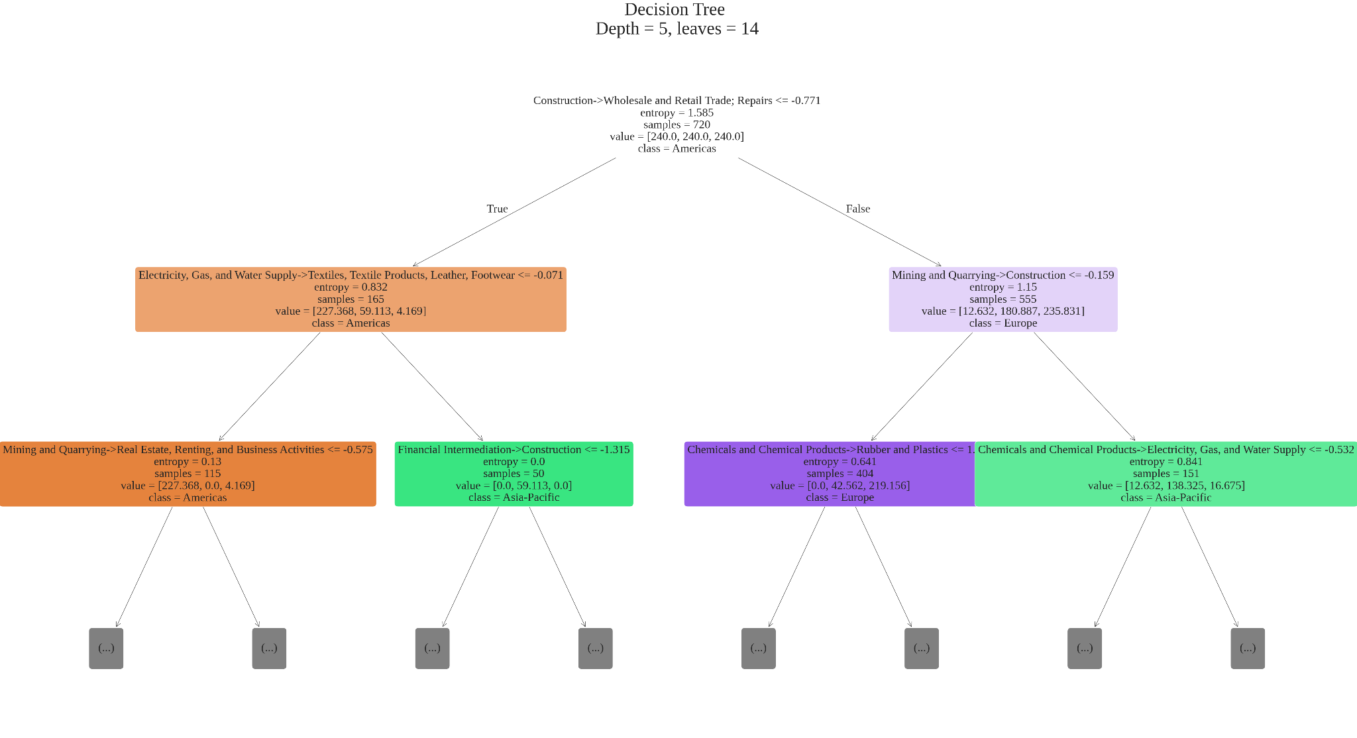
First 2 levels of the Decision Tree

Slide 35
Feature importances are computed as:
Shows how much each feature contributes to reducing impurity (e.g., Gini).
Calculated by summing the impurity decrease from all splits using that feature.
Higher values implies more influence on the tree’s decisions.
Feature Importance chart of the Decision Tree
Notes:
https://scikit-learn.org/stable/auto_examples/ensemble/plot_forest_importances.html

Slide 36
Try unsupervised Clustering to see if we obtain similar results

Slide 37
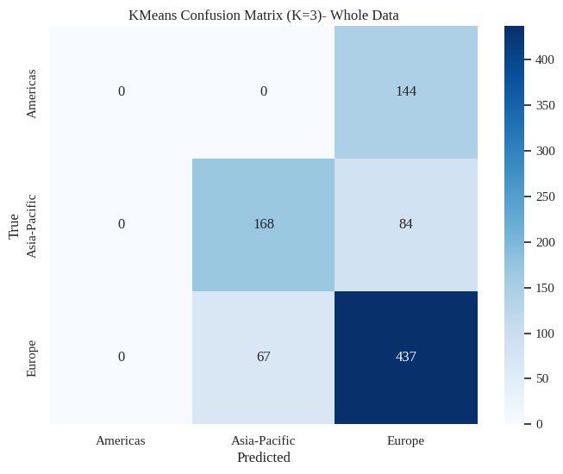
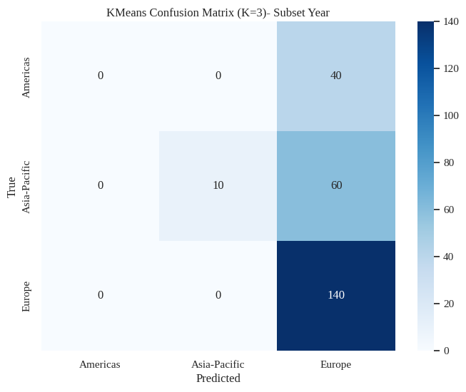
K-Means Clustering
We set K=3 to capture meaningful representation of the three regions: Europe, Asia-Pacific, and Americas.
Implemented K-Means Clustering on:
All available data
The Forecasting subset
To evaluate cluster performance:
Assigned each cluster a label based on a majority vote of countries within the cluster.
Used confusion matrices to assess how well clusters correspond to actual regional classifications.
The models show strong class imbalance, heavily favoring predictions for Europe while being largely insensitive to the Americas class.

Slide 38


Clustering with Reduced Dimensions
Using the same optimal principal components identified in earlier models, we refit the clustering.
However, the clustering once again does not show strong separation among all three regions, unlike the clearer distinctions observed with the KNN algorithm

Slide 39
Analysis
Raw clustering into three groups shows limited sensitivity, which is expected given the nature of the aggregation/grouping of clusters. This doesn’t make separation impossible, but it may require finer breakdowns (e.g., East Asia, Eurasia, Western Europe, North America).
Data limitations highlighted in our EDA constrain the ability to achieve clean separation across all three regions.
Theoretically, if the three (Europe, Asia-Pacific, Americas) regions could be well-separated, class imbalance effects should be minimal, as the three classes would naturally separate and cluster together.
Nonetheless, there’s some visible separation between Asia-Pacific and Europe.
A potential direction is to explore methods that differentiate East (Asia-Pacific) from West (Americas & Europe), possibly by using targeted feature engineering.

Slide 40
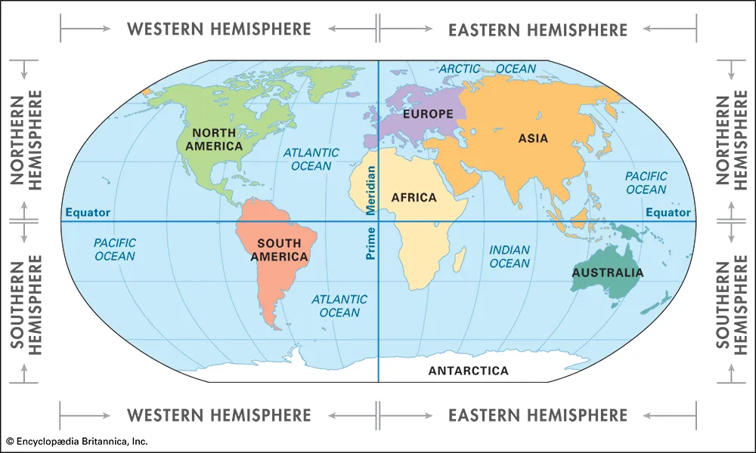
Some exploration
The silhouette score measures how similar a point is to its own cluster compared to the nearest other cluster. Values close to 1 indicate well-separated clusters, while values near 0 suggest overlapping clusters.
To optimize this metric, we focus on broader structural patterns and set aside the finer distinctions captured by KNN, where the regional differences explored earlier are likely very specific and nuanced.
To further investigate, we use silhouette scores to determine an optimal number of clusters (K) for our data.
Optimal K by silhouette: 2
This supports the idea that the data may naturally split into East vs. West regions rather than three distinct groups.
Geopolitical considerations:
Australia is geographically in the East but often classified as “Western” in political science; we account for both perspectives in the clustering (ie fitting two different models, geographically and politically).
South America, despite being a separate continent, historically has high European influence and settlement; it will be treated as part of the Western group.

Slide 41
We used this newly structured data and essentially redid the earlier classification (with East/West labels). The following only contains some of the new and interesting results.
Generally, KNN did well, forecasting seems to be affected the most by class imbalance.
More details are in our Notebook

Slide 42
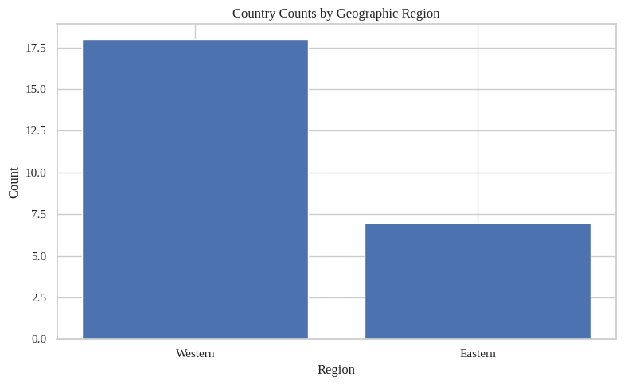
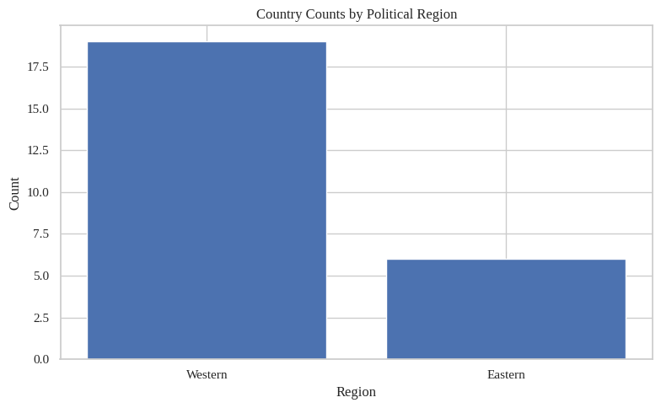
Classes EDA- Definitely class imbalance which may impact our model.

Slide 43
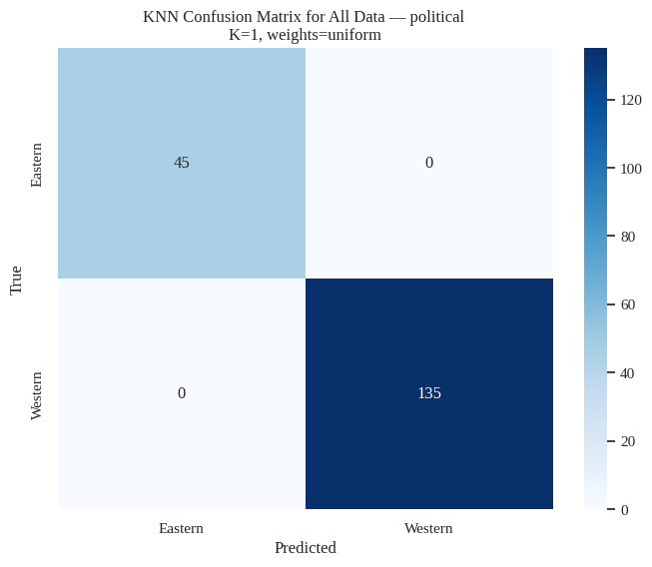
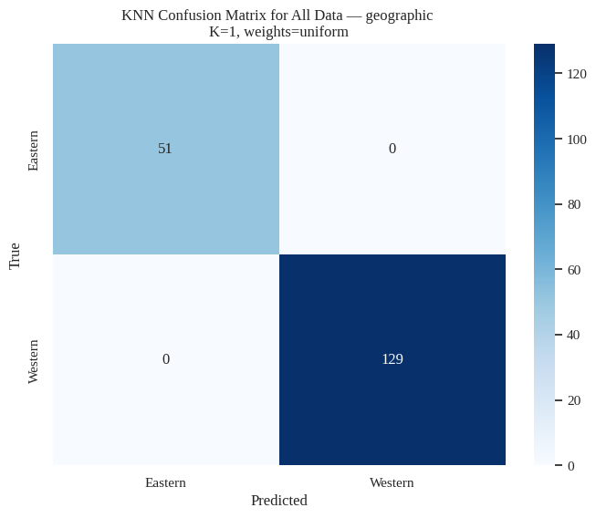
EDA on Robustness of New Classes - Very sensitive

Slide 44
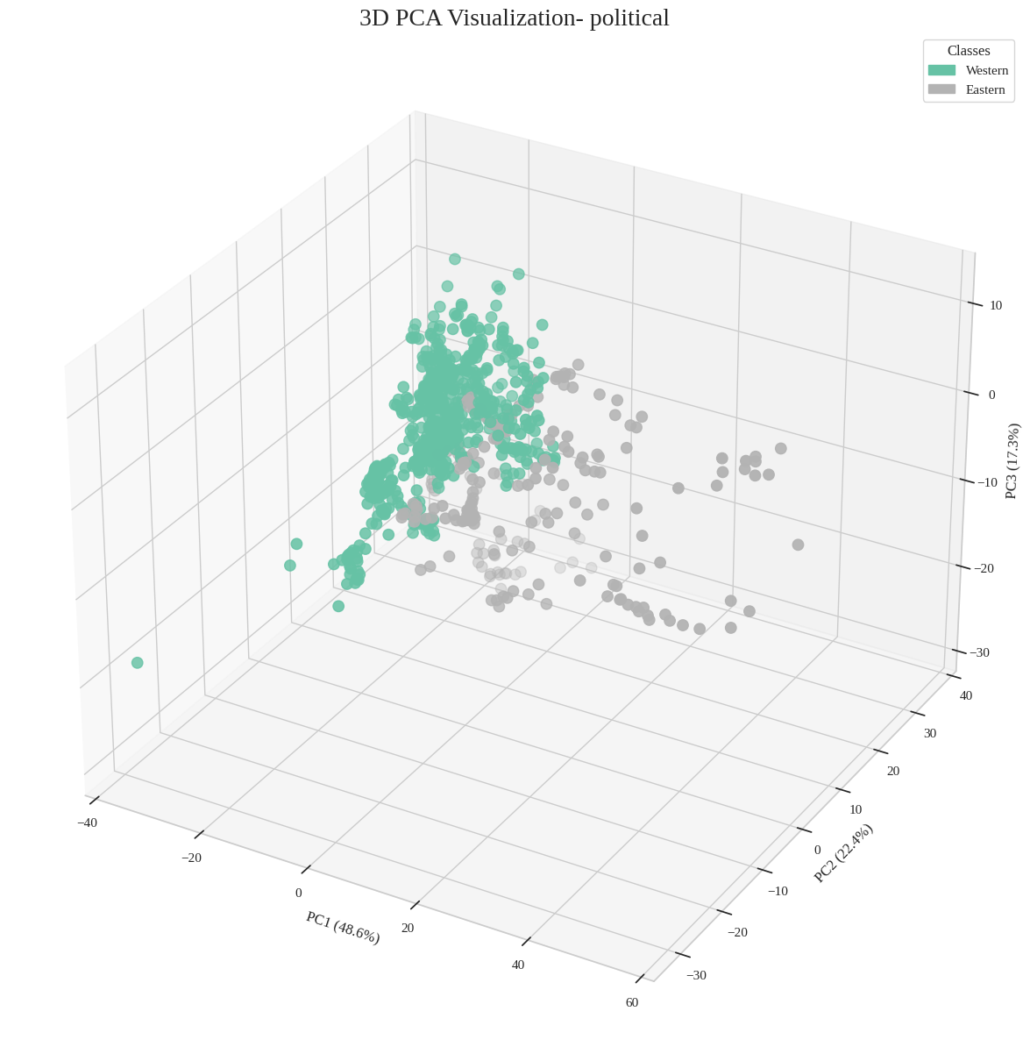
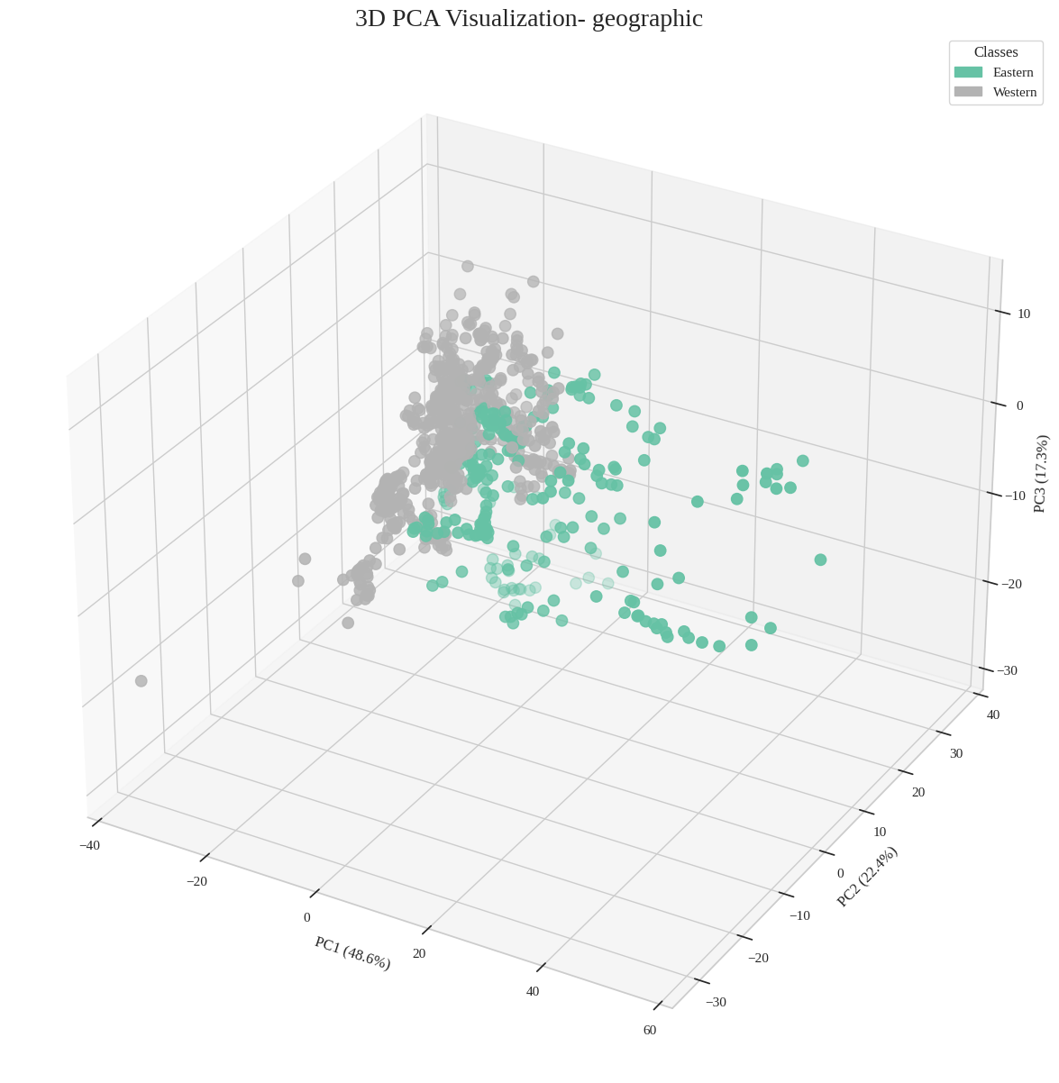
New Result
PCA is highly effective at separating these new classes, unlike the finer distinctions observed with KNN.
This aligns with our expectation that these classes represent more general groupings rather than nuanced differences.
K-Means, being an aggregate-focused algorithm, is naturally more sensitive to broader, larger-scale patterns, which explains why it captures general separations better than specific regional distinctions.

Slide 45
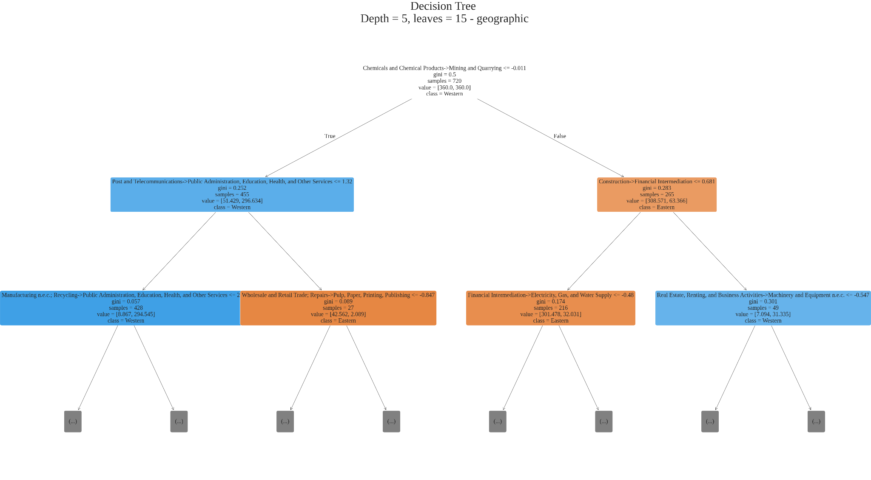
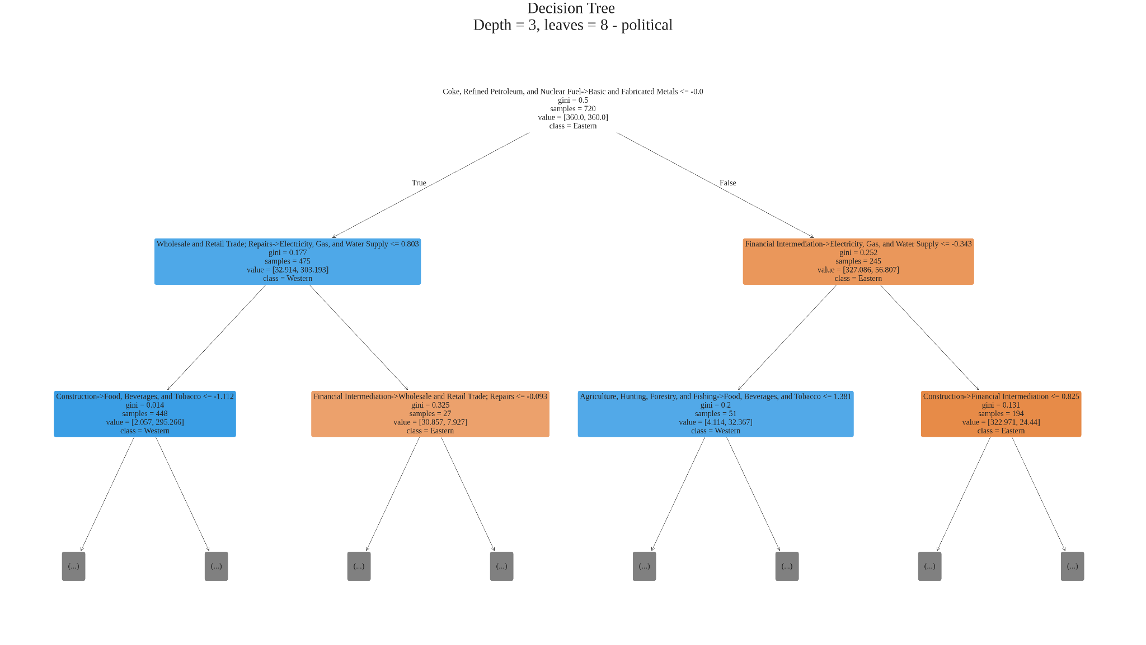
New Decision Trees
Political and Geographic Trees are structured extremely differently.
Top splits are completely different
Feature Importance also takes on a whole different structure.
Full Visualizations are available in the notebook.

Slide 46
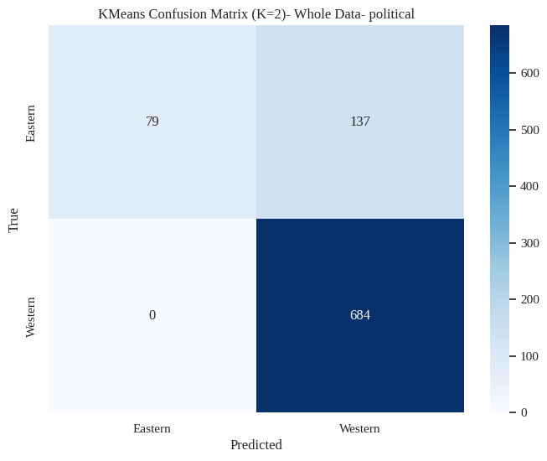
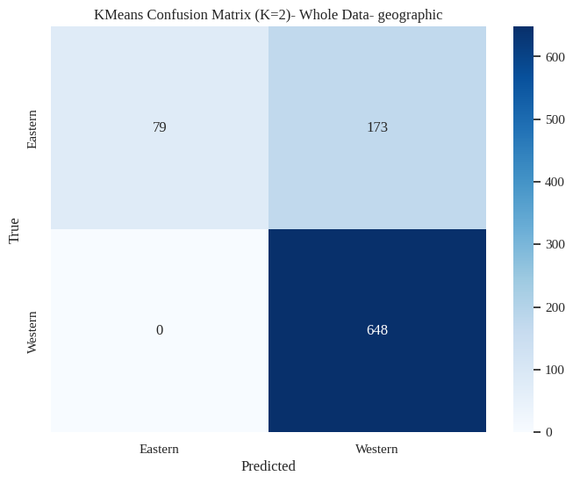
Clustering Results (2 classes) Whole Data

Slide 47

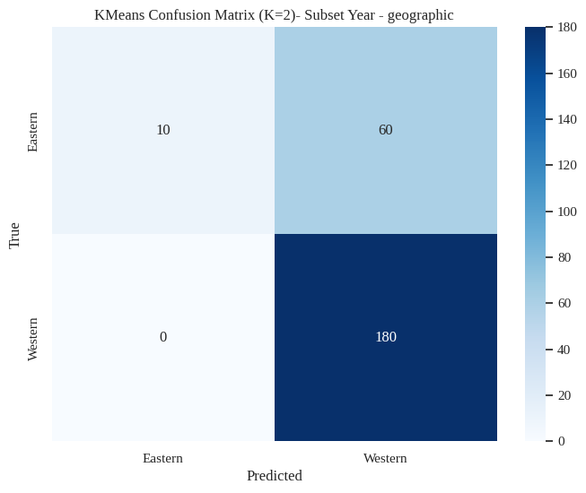
Clustering Results (2 classes) Forecasting

Slide 48
Clustering Observations
Political Labels
All Data
=== Confusion Matrix Metrics (Whole Data) ===
Accuracy: 0.8477777777777777
Precision (macro): 0.9165651644336175
Recall (macro): 0.6828703703703703
F1 Score (macro): 0.7222816600033786
-------------------------------------------
Forecast Data
=== Confusion Matrix Metrics (Subset Year) ===
Accuracy: 0.8
Precision (macro): 0.8958333333333333
Recall (macro): 0.5833333333333334
F1 Score (macro): 0.584717607973422
--------------------------------------------
Geographic Labels
All Data
=== Confusion Matrix Metrics (Whole Data) ===
Accuracy: 0.8077777777777778
Precision (macro): 0.8946406820950061
Recall (macro): 0.6567460317460317
F1 Score (macro): 0.679787100582224
-------------------------------------------
Forecast Data
=== Confusion Matrix Metrics (Subset Year) ===
Accuracy: 0.76
Precision (macro): 0.875
Recall (macro): 0.5714285714285714
F1 Score (macro): 0.5535714285714286
--------------------------------------------

Slide 49
Clustering Analysis
K-Means favors large, structurally similar clusters, resulting in a dominant Western cluster.
Average accuracy, probably due to the class imbalance
The model tends to predict the Western class by default, only switching to Eastern when highly confident.
Low recall for non-Western groups
Smaller or structurally distinct regions (Asia-Pacific, Eastern) are not well separated in raw I/O structure.
Precision > Recall
When the model identifies Eastern economies, the predictions are usually accurate.
However, the model is not very sensitive to these groups and rarely assigns them.
Geopolitical and geographic labels show similar behavior
With K-Means, economic structures cluster more cleanly into East vs. West rather than Europe–Asia–Americas, reflecting the algorithm’s aggregate nature.

Slide 50
Conclusion
There are clear structural differences in economic systems reflected in the Leontief inverse matrices. KNN, being a more local classification method, is able to capture these nuanced regional distinctions and differentiate smaller regions more effectively.
In contrast, K-Means, which relies on broad aggregation, struggles when differences between regions are subtle; as a result, it tends to form large, dominant clusters, especially under class imbalance.
Given these properties, K-Means is better suited to identifying general economic structural groupings, but not specific geopolitical or geographic regions.
This leads to the model overwhelmingly assigning observations to a Western cluster, highlighting the difficulty of clustering regions whose economic structures vary only in nuanced ways.

Slide 51
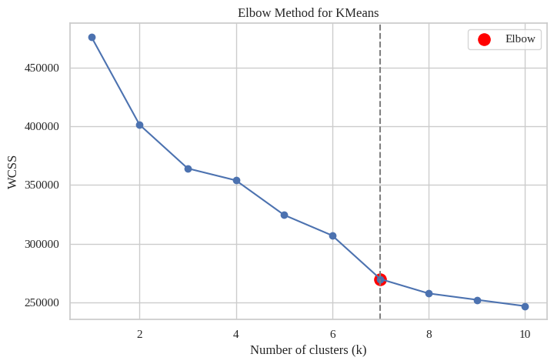
Future steps
Classification
Obtain comparable time-series data for additional countries within each regional class.
Evaluate the robustness of the trained models on unseen countries to test generalization.
Current dataset limitations (small sample size) prevented this analysis, but expanding the dataset would allow stronger validation.
Clustering
Analysis of the WCSS metric suggests an optimal K = 7, indicating potential for more detailed structural groupings.
These clusters may reflect either general economic structure patterns or finer regional subdivisions beyond the East–West/Europe-Asia-America distinction.

Slide 52
References (more in speaker notes)
University of Groningen, Groningen Growth and Development Centre. World Input–Output Database (WIOD): Long-run series. [Online]. Available: https://www.rug.nl/ggdc/valuechain/long-run-wiod
Google Colaboratory. Input–Output analysis notebook (io.ipynb). [Online]. Available: https://colab.research.google.com/notebooks/io.ipynb
University of Maryland, Department of Mathematics. Leontief Input–Output Model. [Online]. Available: https://www.math.umd.edu/~immortal/MATH401/book/ch_leontief.pdf
The Pandas Development Team. Pandas Documentation. [Online]. Available: https://pandas.pydata.org/docs/
M. Waskom et al., “Seaborn: Statistical Data Visualization — Heatmap,” [Online]. Available: https://seaborn.pydata.org/generated/seaborn.heatmap.html
M. Waskom et al., “Seaborn: Statistical Data Visualization — Lineplot,” [Online]. Available: https://seaborn.pydata.org/generated/seaborn.lineplot.html
M. Waskom et al., “Seaborn Tutorial: Color Palettes,” [Online]. Available: https://seaborn.pydata.org/tutorial/color_palettes.html
M. Waskom et al., “Seaborn Objects: Plot.label Method,” [Online]. Available: https://seaborn.pydata.org/generated/seaborn.objects.Plot.label.html
The Matplotlib Development Team. Matplotlib Font Manager API Documentation. [Online]. Available: https://matplotlib.org/stable/api/font_manager_api.html
Notes:
[1] GeeksforGeeks. 2025. Curse of Dimensionality in Machine Learning. Geeks-
forGeeks. Last updated 23 July 2025. Available at: https://www.geeksforgeeks.
org/machine-learning/curse-of-dimensionality-in-machine-learning/ (accessed
Dec. 11, 2025). :contentReference[oaicite:0]index=0
[2] D. T. Coe and S.-J. Kim, editors. 2001. Korean Crisis and Recovery: Papers Presented
at a Conference held in Seoul, Korea, May 17–19, 2001. Seoul, Korea.
[3] P. Woltjer, R. Gouma, and M. P. Timmer. 2021. Long-run World Input-Output
Database: Version 1.1 Sources and Methods. GGDC Research Memorandum 190.
Groningen Growth and Development Centre, University of Groningen. Avail-
able at: https://www.rug.nl/ggdc/html_publications/memorandum/gd190.pdf
(accessed Dec. 11, 2025).
[4] Investopedia. 2025. Economic Cycle. Available at: https://www.investopedia.com/
terms/e/economic-cycle.asp (accessed Dec. 11, 2025).
[5] V. Satopaa, J. Albrecht, D. Irwin, and B. Raghavan. 2011. Finding a “Kneedle” in
a Haystack: Detecting Knee Points in System Behavior. Simplex11 Proceedings.
Available at: https://raghavan.usc.edu/papers/kneedle-simplex11.pdf (accessed
Dec. 11, 2025).
[6] “World Input-Output Database, 2021 Release, 1965 -2000 Long - run WIOD.” 2021.
Dataverse NL. Available at: https://dataverse.nl/dataset.xhtml?persistentId=doi:
10.34894/A7AXDN (accessed Dec. 11, 2025). :contentReference[oaicite:4]index=4
[7] Google Colaboratory. 2025. Input–Output analysis notebook (io.ipynb). Available
at: https://colab.research.google.com/notebooks/io.ipynb (accessed Dec. 11, 2025).
[8] University of Maryland, Department of Mathematics. 2025. Leontief Input–Output
Model. Available at: https://www.math.umd.edu/~immortal/MATH401/book/ch_
leontief.pdf (accessed Dec. 11, 2025).
[9] The Pandas Development Team. 2025. Pandas Documentation. Available at: https:
//pandas.pydata.org/docs/ (accessed Dec. 11, 2025).
[10] M. Waskom et al. 2025. Seaborn: Statistical Data Visualization — Heatmap. Avail-
able at: https://seaborn.pydata.org/generated/seaborn.heatmap.html (accessed
Dec. 11, 2025).
[11] M. Waskom et al. 2025. Seaborn: Statistical Data Visualization — Lineplot. Available
at: https://seaborn.pydata.org/generated/seaborn.lineplot.html (accessed Dec. 11,
2025).
[12] M. Waskom et al. 2025. Seaborn Tutorial: Color Palettes. Available at: https://
seaborn.pydata.org/tutorial/color_palettes.html (accessed Dec. 11, 2025).
[13] M. Waskom et al. 2025. Seaborn Objects: Plot.label Method. Available at: https:
//seaborn.pydata.org/generated/seaborn.objects.Plot.label.html (accessed Dec. 11,
2025).
[14] Matplotlib Development Team. 2025. Matplotlib Font Manager API Documentation.
Available at: https://matplotlib.org/stable/api/font_manager_api.html (accessed
Dec. 11, 2025).
[15] Scikit -learn Developers. 2025. Plot Feature Importances Using Forest of Trees.
Available at: https://scikit-learn.org/stable/auto_examples/ensemble/plot_forest_
importances.html (accessed Dec. 11, 2025).

